Slide 1
Data Quality Lake – Automated Data Validation Pipeline

Slide 2
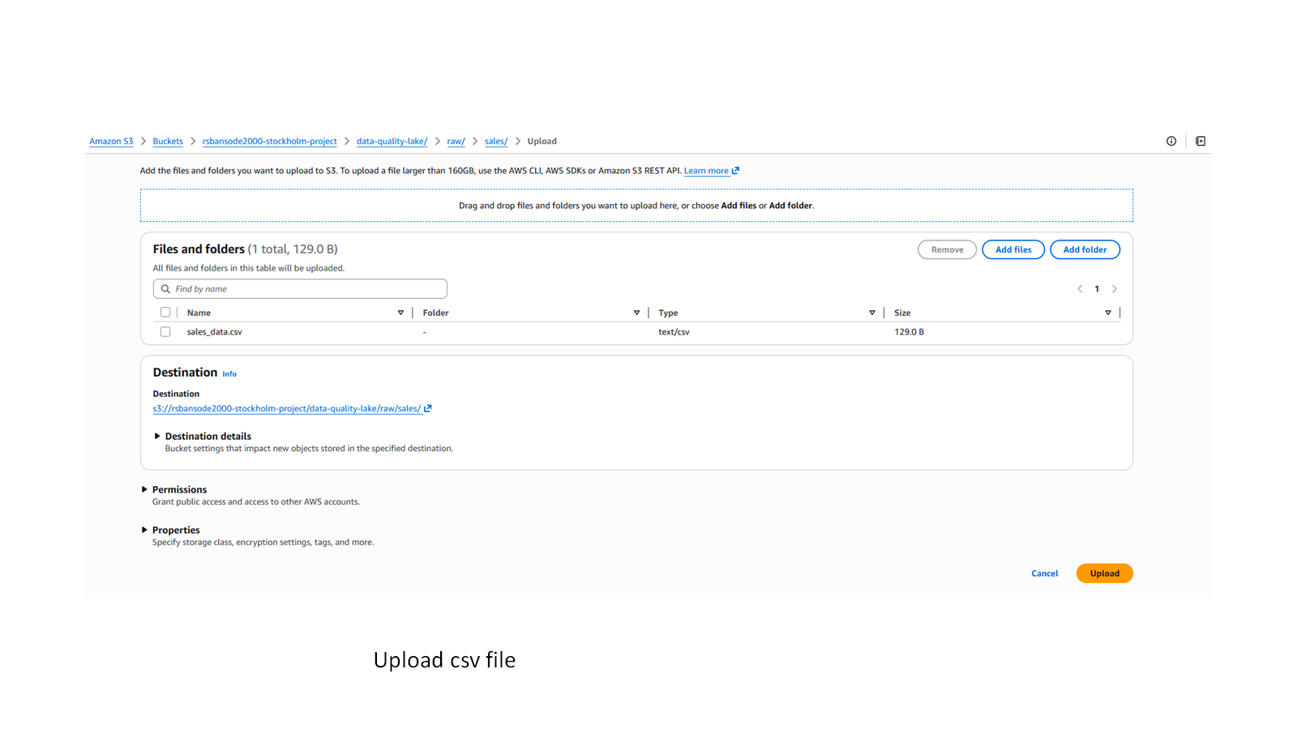


Upload csv file in S3 bucket

Slide 3
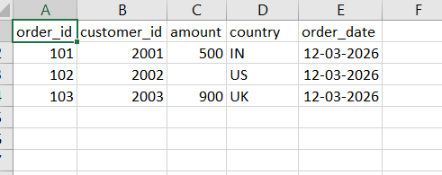
CSV file has one value null in amount

Slide 4
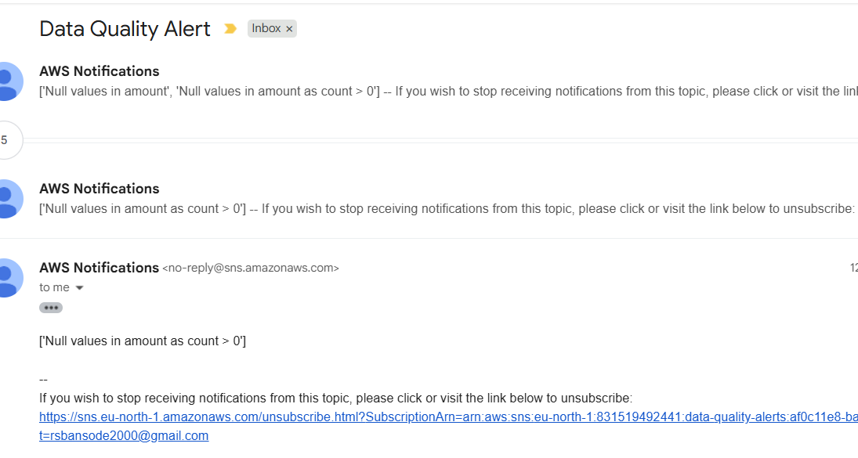
Got mail notification in dq check fails

Slide 5
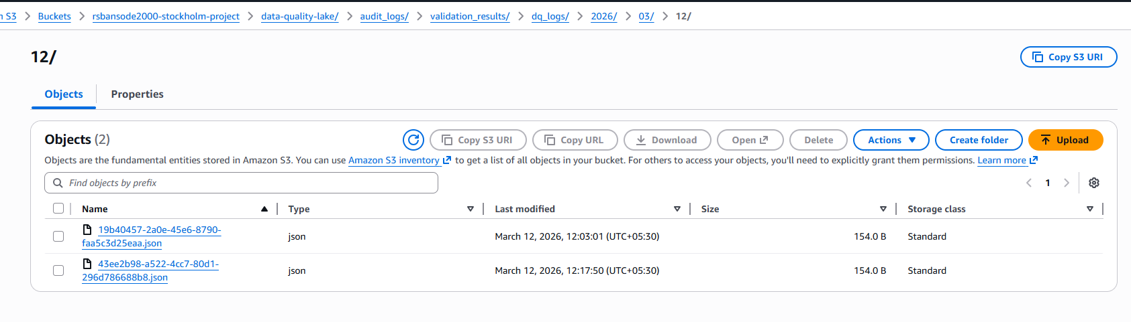


Logs generated in S3

Slide 6
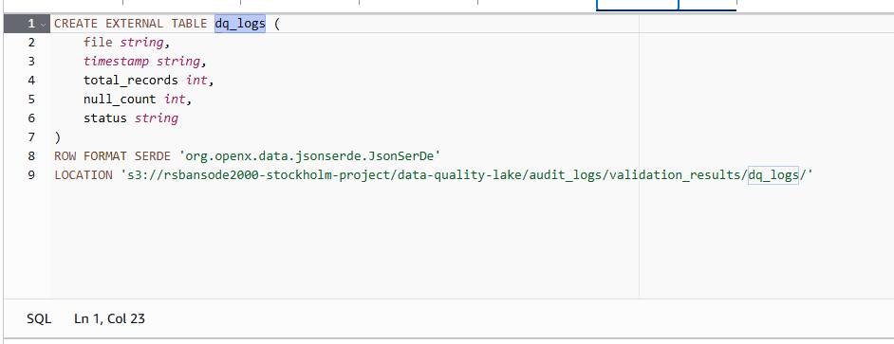

Create external table for logs

Slide 7
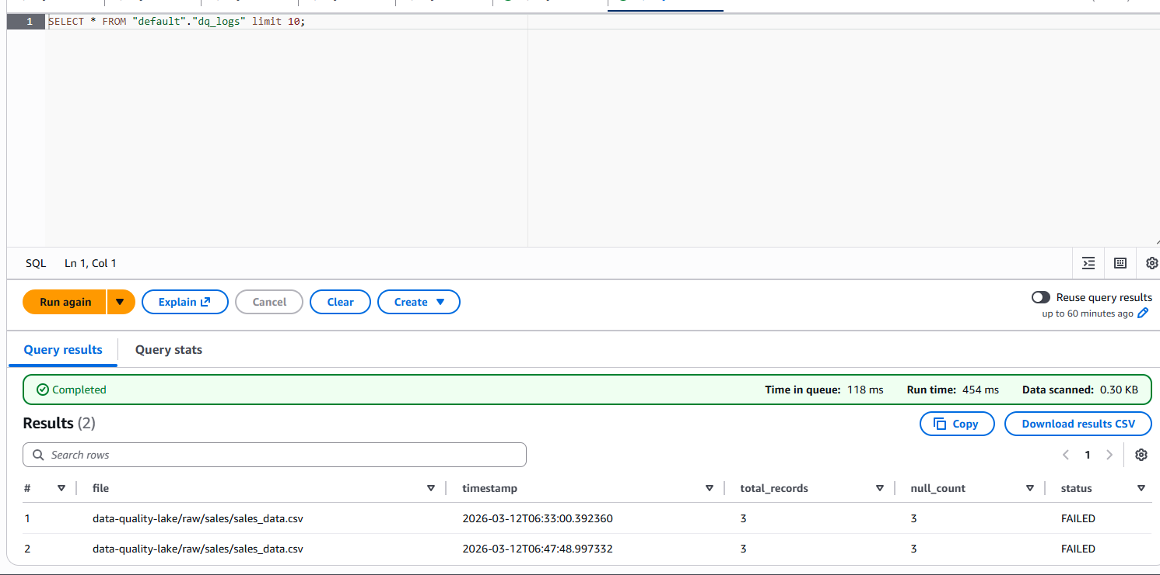
Query on logs data

Slide 8
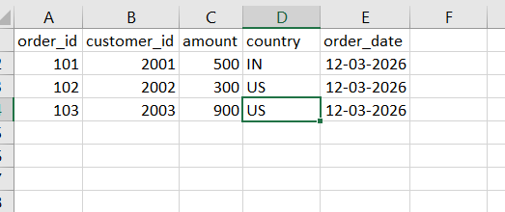
Upload correct file

Slide 9
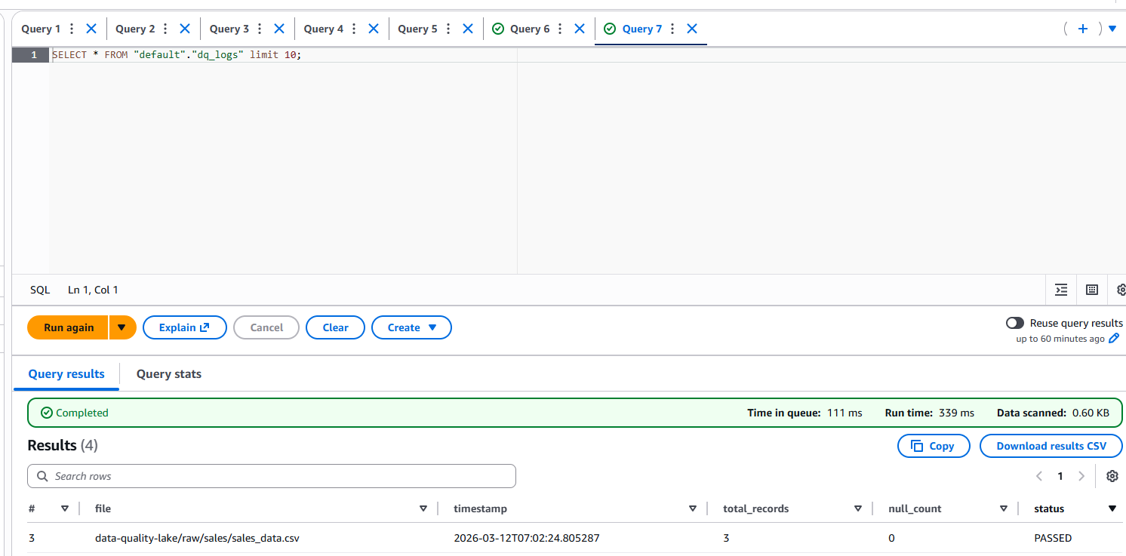
New record dq check pass

Slide 10
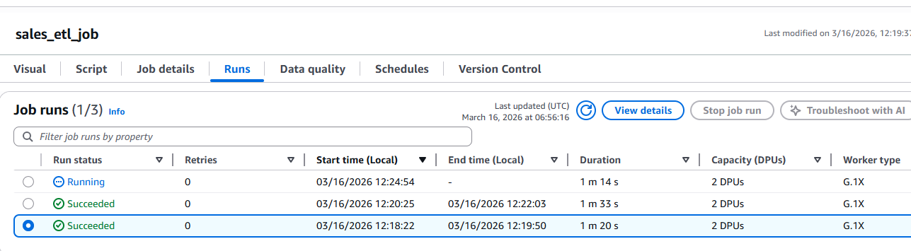
Glue job triggered

Slide 11
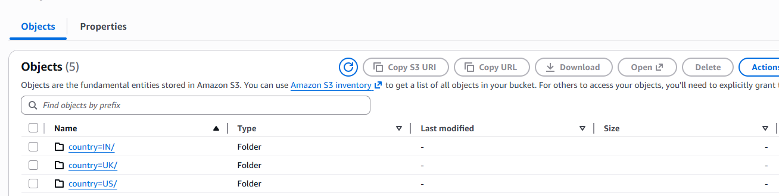
Partition wise data stored as parquet in S3

Slide 12
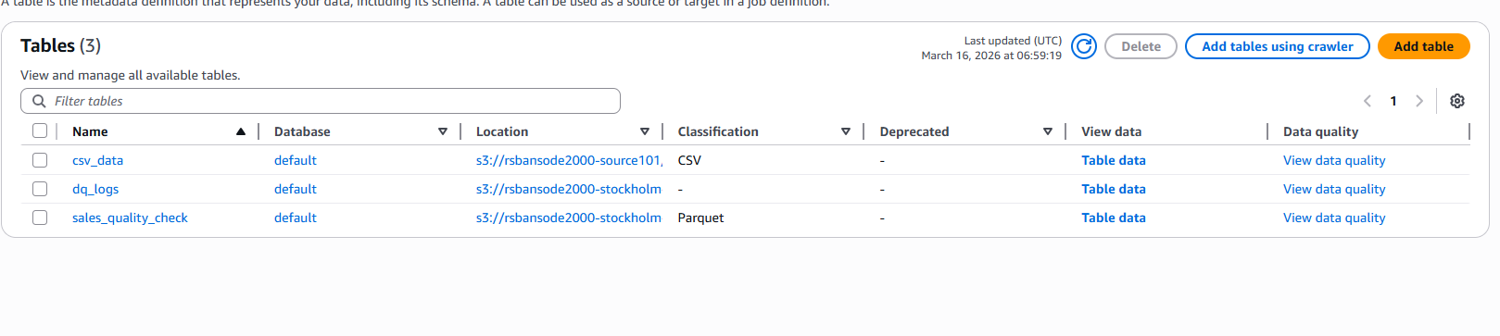
Sales_quality_check table created in glue catalog

Slide 13
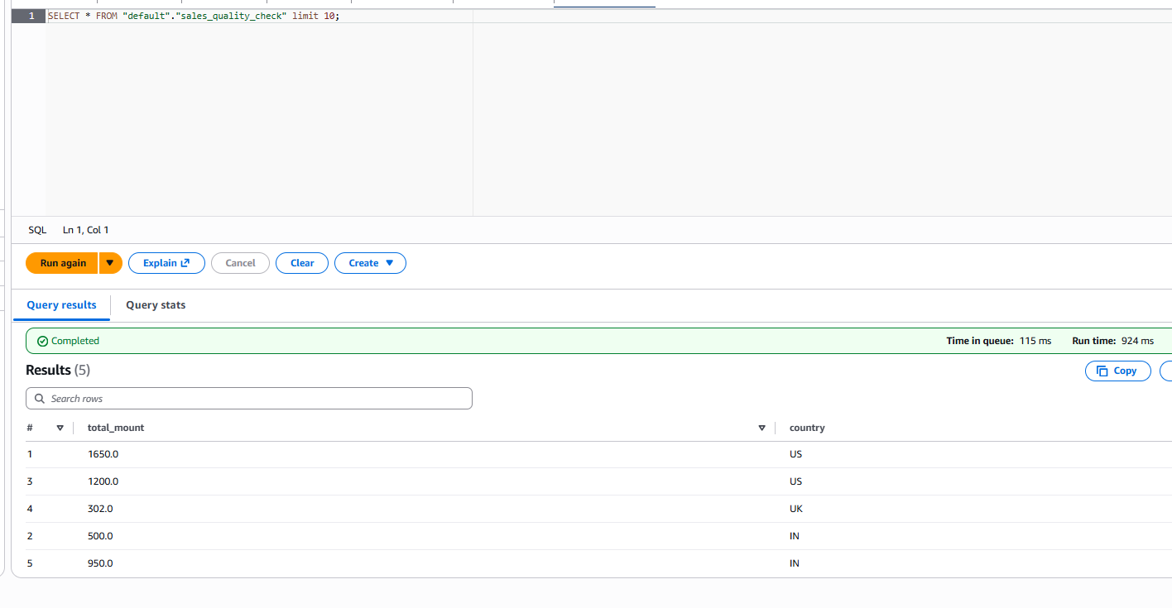
Query on processed data

